Slide 1

Platform CenturyLink Internal Network Phase Data Lake Infrastructure

Slide 2
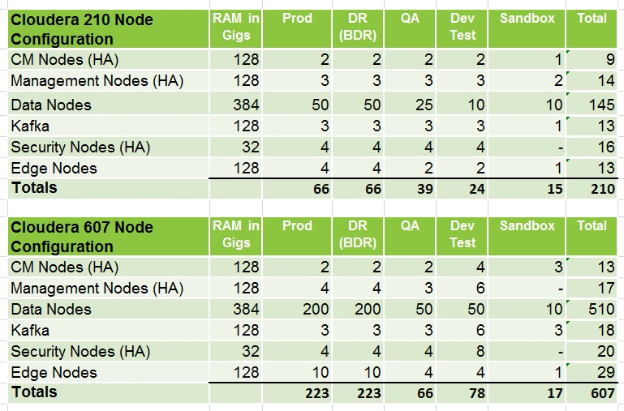
Cloudera Hadoop Config

Slide 3
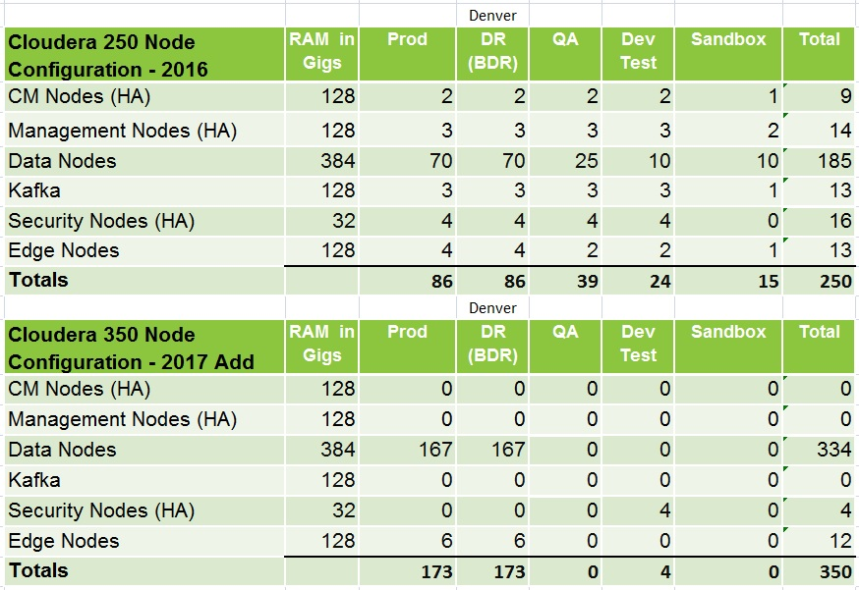
250 + 350 = 600

Slide 4
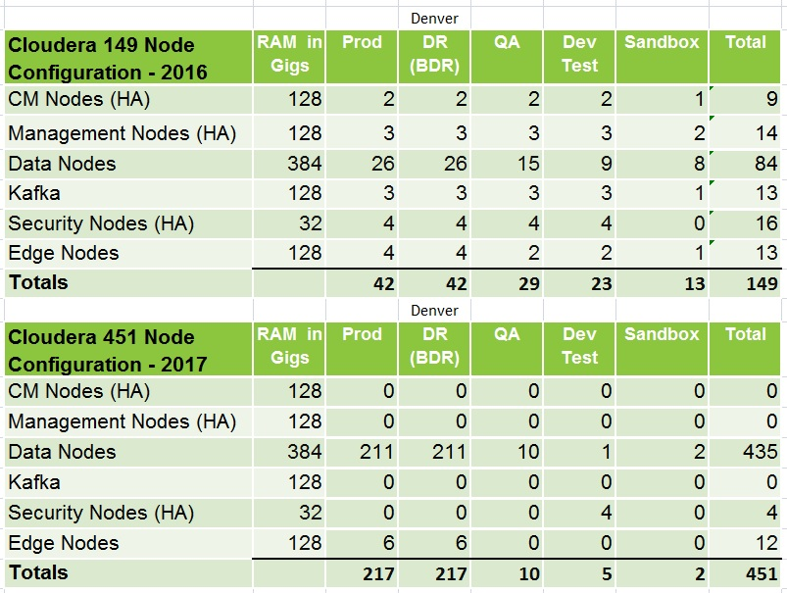
149 + 451 = 600

Slide 5
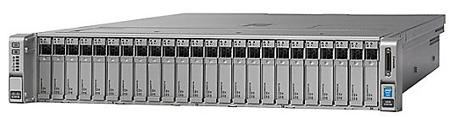
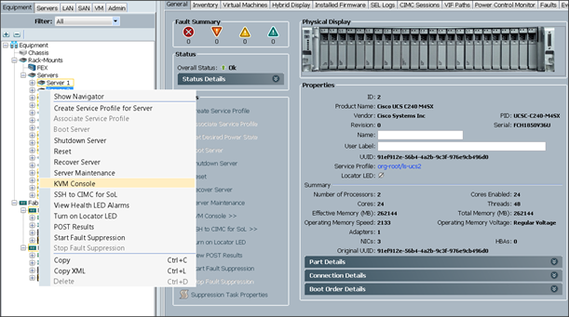
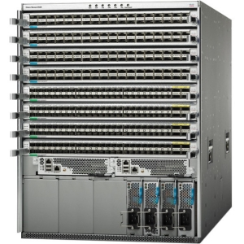
UCS C240 M4 - Data Node
Two CPUs
2.40 GHz E5-2680
14 cores each
Storage
12 SFF Drives
Expandable to 24
IMC Supervisor
Single Management Dashboard
Power & Cooling
1/3 less infrastructure
Lower Power
Embedded Management
Removes switches, Adapters and Modules
Unified Fabric: Network, Storage, Management

Slide 6
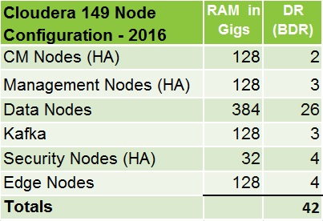
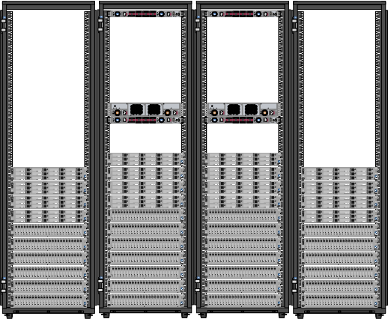
Denver - 2016

Slide 7
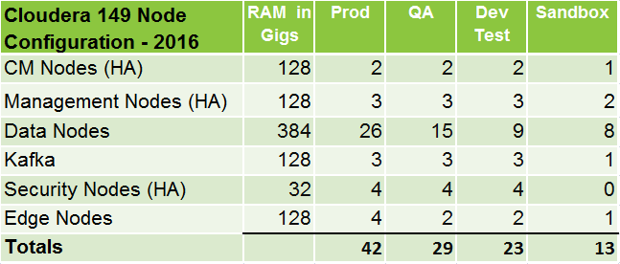
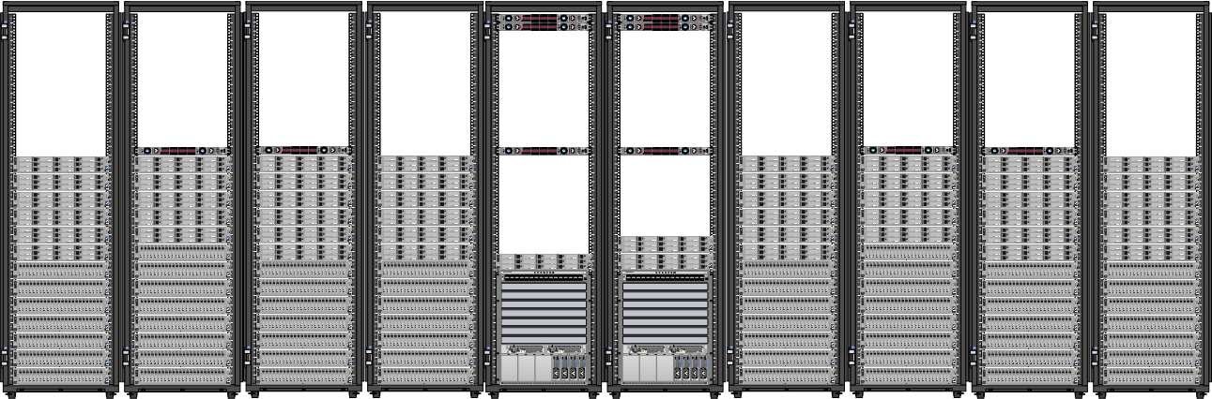
Omaha - 2016

Slide 8
Storage Costs - Looking to the Horizon
120K
Data Nodes
With 12 HDDs
~$659/TB
100K
90K
80K
Data Nodes
With 24 HDDs
~$401/TB
70K
60K
$
50K
ISILON
~$236/TB
40K
Object
Storage
30K
20K
Cost of Disk
$140/TB
10K
907 TBs
1.8 x 12 x 42
(Production)
20
30
40
50
60
70
80
90
100
120
130
140
150
160
170
Effective Storage in TBs

Slide 9
Title

